Slide 1

Lab Book 2.0. Couplers
Student: Andrés Sanchez-Toril

Slide 2
Instructions
General
SCRIPTS
From GitHub →
  Fork the repo: https://github.com/cccanvas-upv/pic-upv-lab2.git
  Clone the repo using VSCode
Run the Jupyter Notebook:
  COUPLERS_Student.ipynb
Cross-Sections to be studied:
w (width)
w (width)
h
(height)
Core
Core
h
(height)
MMI Body
g
(gap)
Cladding
Cladding
Directional coupler (DC)
Multimode Interference (MMI) coupler

Slide 3
Directional coupler

Slide 4
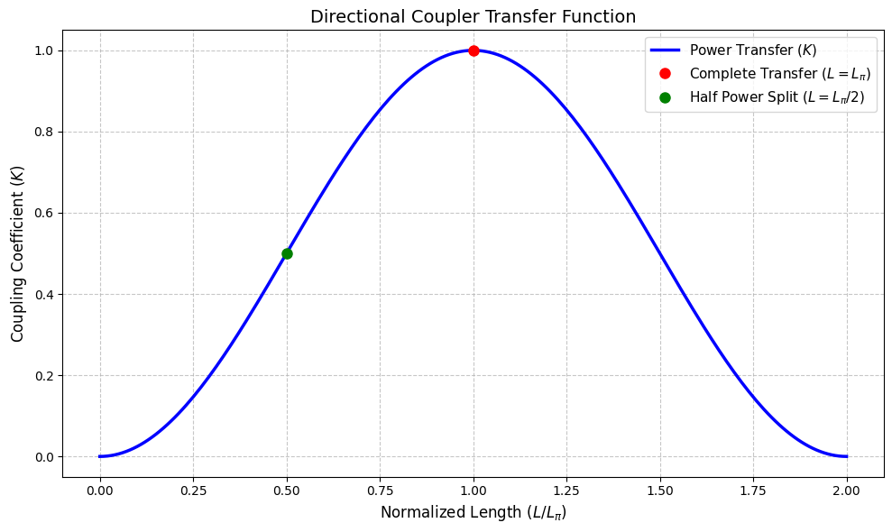
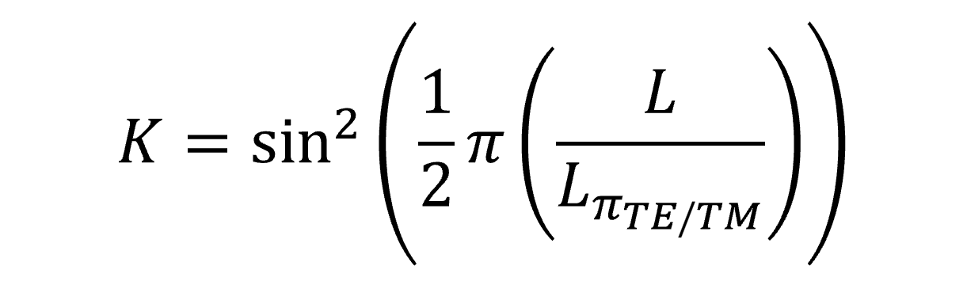
Learning outcome #1 – Directional coupler length and coupling coefficient
Wavelength 1.5 µm – width 1.2 µm – gap 0.6 µm
deep waveguide
Paste L/Lpi vs K plot here
Comment results (distance needed for a complete energy transfer between waveguides, distance needed for splitting power in half.. )
For complete energy transfer, the argument of the sine must be equal to pi/2. For this to happen, the physical length must be equal to the beat length. Similarly, to transfer half of the power, the argument must be pi/4, which leads to the length being half of the beat length.
These values are, correspondingly: 93.84 μm and 46.92 μm.

Slide 5
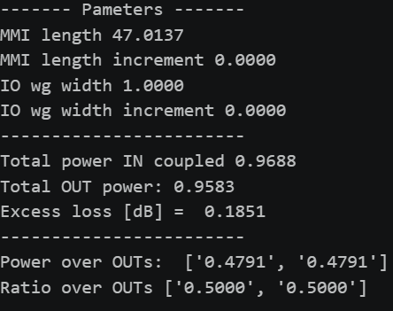
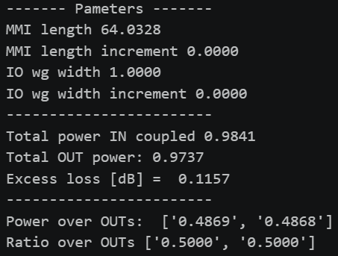
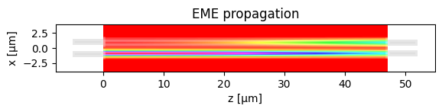
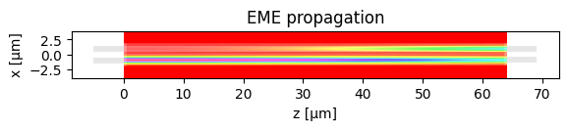
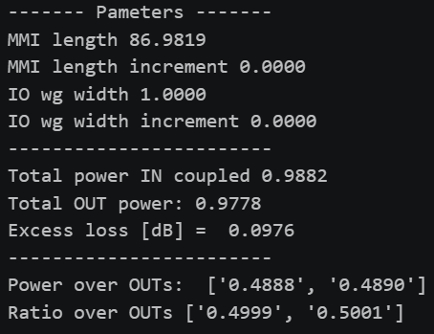
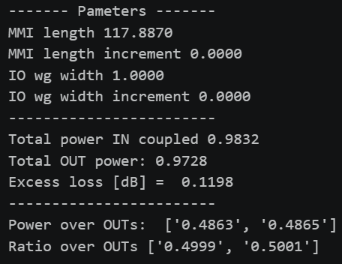
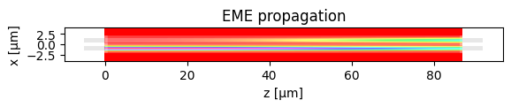
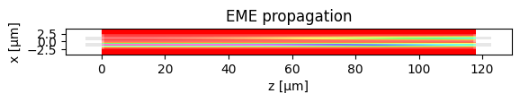
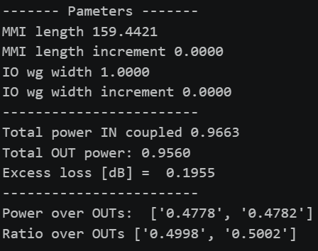
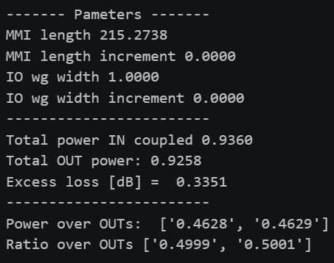
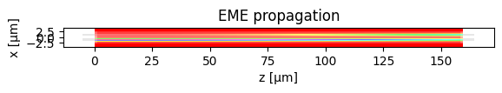
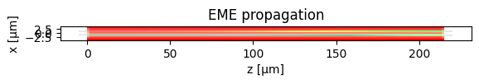
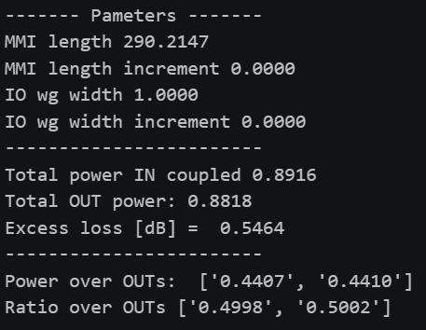
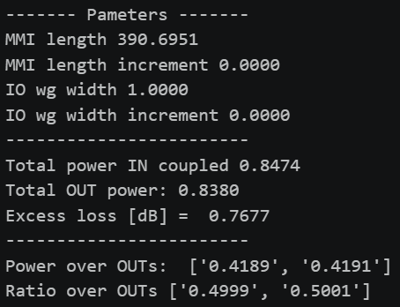


Learning outcome #2 – 2x2 Directional Coupler
Gap 0.6 - 1.6 µm (step 0.1 µm) – Wavelength 1.55 µm
Gap 0,6
Gap 0,7
Gap 0,8
Gap 0,9
Gap 1,0
Gap 1,1
Gap 1,2
Gap 1,3

Slide 6
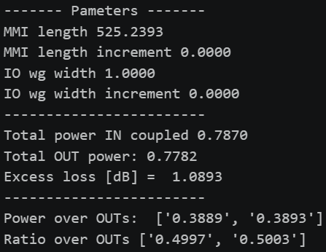
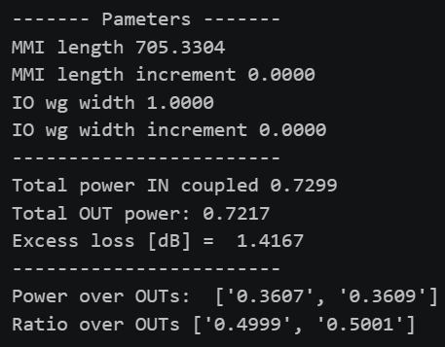


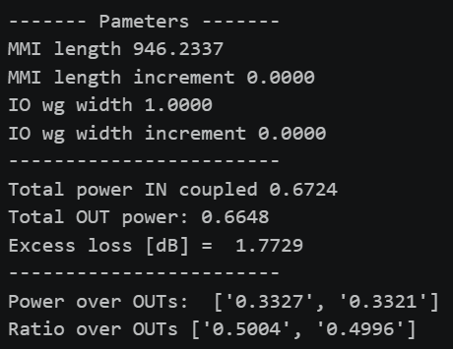

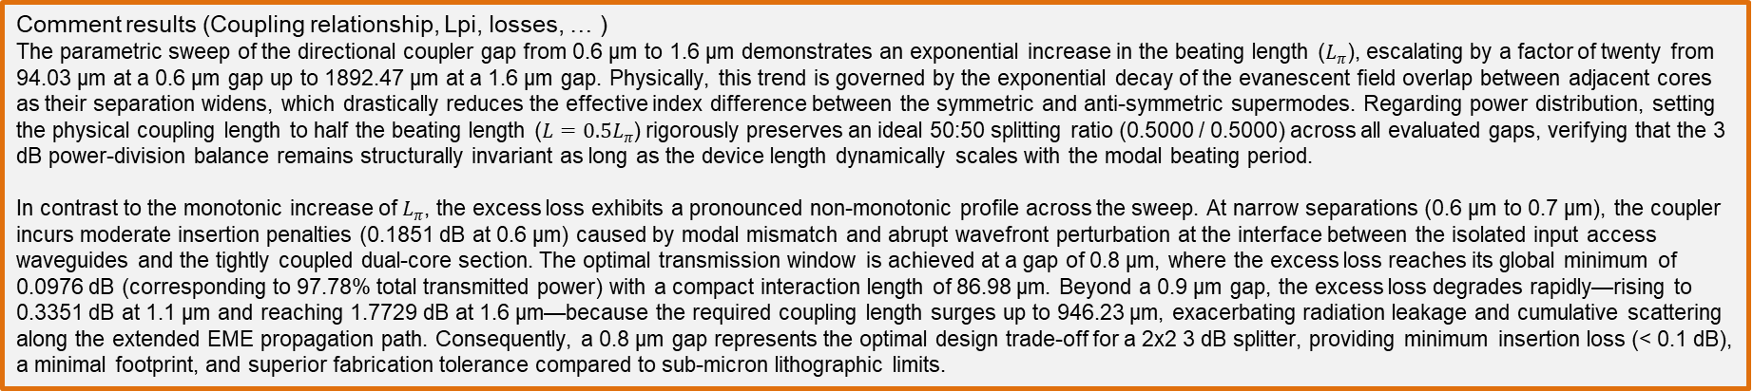
Gap 1,4
Gap 1,5
Gap 1,6
Comment results (Coupling relationship, Lpi, losses, … )
The parametric sweep of the directional coupler gap from 0.6 µm to 1.6 µm demonstrates an exponential increase in the beating length ($L_{π}$), escalating by a factor of twenty from 94.03 µm at a 0.6 µm gap up to 1892.47 µm at a 1.6 µm gap. Physically, this trend is governed by the exponential decay of the evanescent field overlap between adjacent cores as their separation widens, which drastically reduces the effective index difference between the symmetric and anti-symmetric supermodes. Regarding power distribution, setting the physical coupling length to half the beating length ($L=0.5L_{π}$) rigorously preserves an ideal 50:50 splitting ratio (0.5000 / 0.5000) across all evaluated gaps, verifying that the 3 dB power-division balance remains structurally invariant as long as the device length dynamically scales with the modal beating period.
In contrast to the monotonic increase of $L_{π}$, the excess loss exhibits a pronounced non-monotonic profile across the sweep. At narrow separations (0.6 µm to 0.7 µm), the coupler incurs moderate insertion penalties (0.1851 dB at 0.6 µm) caused by modal mismatch and abrupt wavefront perturbation at the interface between the isolated input access waveguides and the tightly coupled dual-core section. The optimal transmission window is achieved at a gap of 0.8 µm, where the excess loss reaches its global minimum of 0.0976 dB (corresponding to 97.78% total transmitted power) with a compact interaction length of 86.98 µm. Beyond a 0.9 µm gap, the excess loss degrades rapidly—rising to 0.3351 dB at 1.1 µm and reaching 1.7729 dB at 1.6 µm—because the required coupling length surges up to 946.23 µm, exacerbating radiation leakage and cumulative scattering along the extended EME propagation path. Consequently, a 0.8 µm gap represents the optimal design trade-off for a 2x2 3 dB splitter, providing minimum insertion loss (< 0.1 dB), a minimal footprint, and superior fabrication tolerance compared to sub-micron lithographic limits.

Slide 7
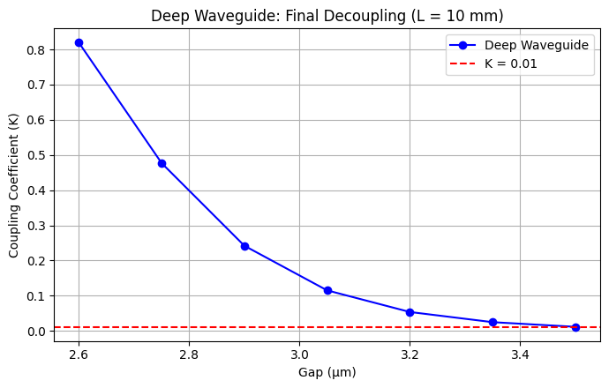
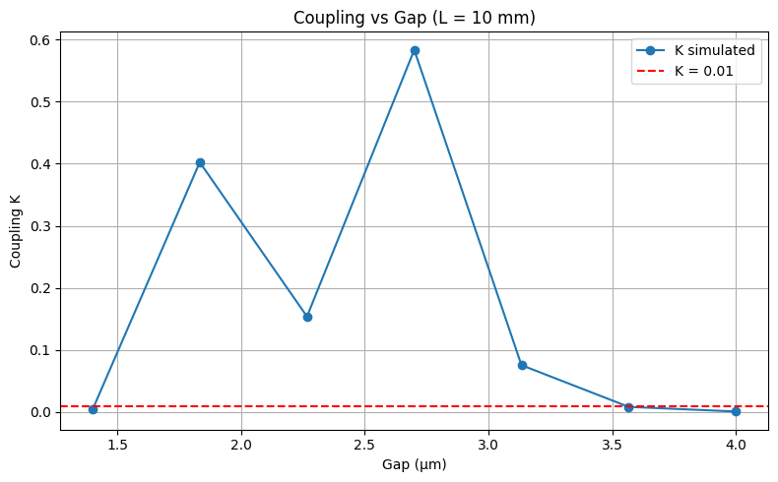
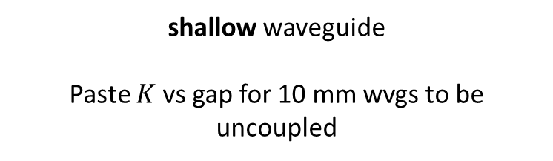
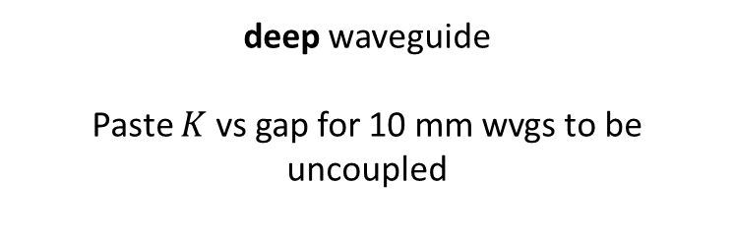
Learning outcome #3 – Parallel uncoupled waveguides
Wavelength 1.55 µm, width 1.0 µm, gap to be found for uncoupled wvgs
deep waveguide
Paste $K$ vs gap for 10 mm wvgs to be uncoupled
shallow waveguide
Paste $K$ vs gap for 10 mm wvgs to be uncoupled
Hints:
All waveguides running in parallel are coupled somehow. Controlling the degree of coupling is key for those waveguides you don’t want coupling over certain level (i.e. uncoupled waveguides). Uncoupled waveguide definition, we will use K<0.01. Parallel waveguide length = 10 mm (typical length of a chip). Find minimum gap shallow / deep w=1.0µm wvl 1.55 µm.

Slide 8
Multimode Interferometer (MMI) Coupler

Slide 9
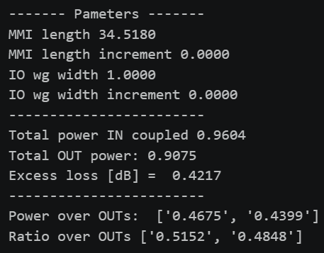
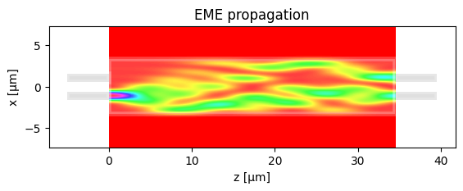
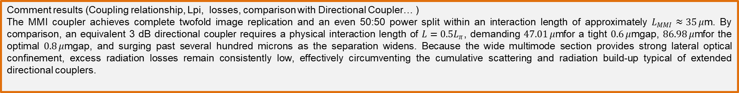
Learning outcome #4 – 4.1 2x2 Multimode Interference Coupler
Wavelength 1.55 µm, wMMI = 6.6 µm
Comment results (Coupling relationship, Lpi, losses, comparison with Directional Coupler… )
The MMI coupler achieves complete twofold image replication and an even 50:50 power split within an interaction length of approximately $L_{MMI}≈35 μ\text{m}$. By comparison, an equivalent 3 dB directional coupler requires a physical interaction length of $L=0.5L_{π}$, demanding $47.01 μ\text{m}$for a tight $0.6 μ\text{m}$gap, $86.98 μ\text{m}$for the optimal $0.8 μ\text{m}$gap, and surging past several hundred microns as the separation widens. Because the wide multimode section provides strong lateral optical confinement, excess radiation losses remain consistently low, effectively circumventing the cumulative scattering and radiation build-up typical of extended directional couplers.

Slide 10

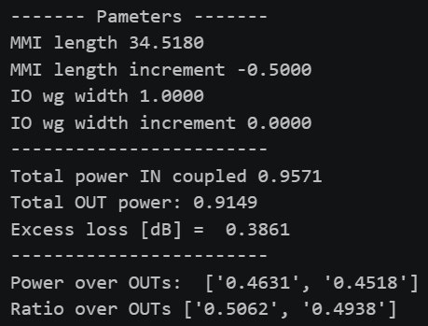
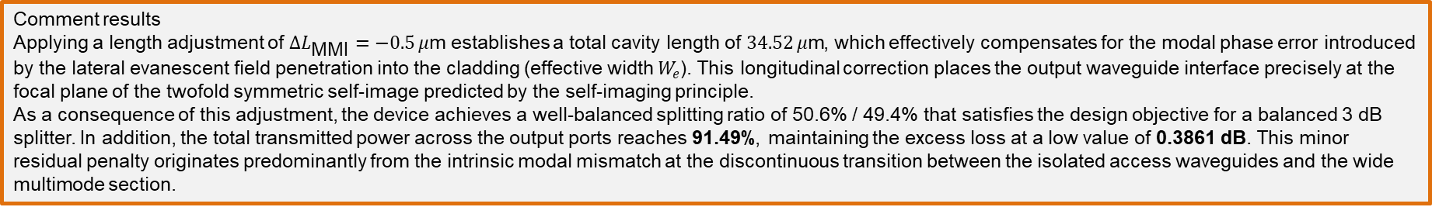
Learning outcome #4.2 – 2x2 Multimode Interference Coupler - Optimization
Wavelength 1.55 µm, wMMI = 6.6 µm
Comment results
Applying a length adjustment of $ΔL_{\text{MMI}}=−0.5 μ\text{m}$establishes a total cavity length of $34.52 μ\text{m}$, which effectively compensates for the modal phase error introduced by the lateral evanescent field penetration into the cladding (effective width $W_{e}$). This longitudinal correction places the output waveguide interface precisely at the focal plane of the twofold symmetric self-image predicted by the self-imaging principle.
As a consequence of this adjustment, the device achieves a well-balanced splitting ratio of 50.6% / 49.4% that satisfies the design objective for a balanced 3 dB splitter. In addition, the total transmitted power across the output ports reaches 91.49%, maintaining the excess loss at a low value of 0.3861 dB. This minor residual penalty originates predominantly from the intrinsic modal mismatch at the discontinuous transition between the isolated access waveguides and the wide multimode section.

Slide 11
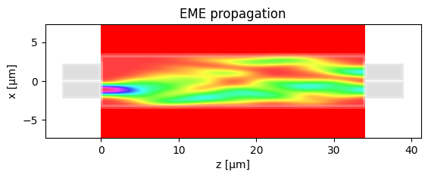
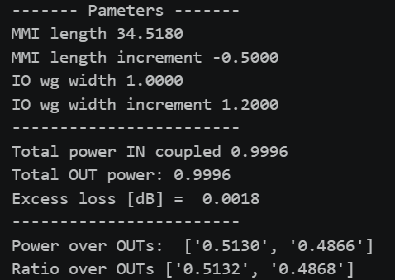
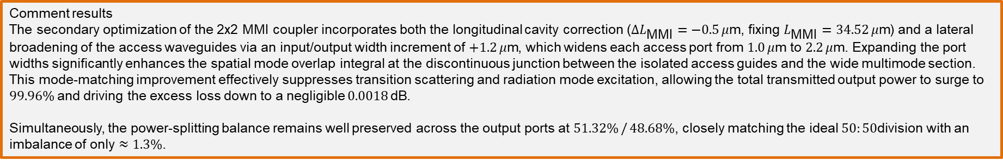
Learning outcome #4.3 – 2x2 Multimode Interference Coupler – Optimization (II)
Wavelength 1.55 µm, wMMI = 6.6 µm
Comment results
The secondary optimization of the 2x2 MMI coupler incorporates both the longitudinal cavity correction ($ΔL_{\text{MMI}}=−0.5 μ\text{m}$, fixing $L_{\text{MMI}}=34.52 μ\text{m}$) and a lateral broadening of the access waveguides via an input/output width increment of $+1.2 μ\text{m}$, which widens each access port from $1.0 μ\text{m}$to $2.2 μ\text{m}$. Expanding the port widths significantly enhances the spatial mode overlap integral at the discontinuous junction between the isolated access guides and the wide multimode section. This mode-matching improvement effectively suppresses transition scattering and radiation mode excitation, allowing the total transmitted output power to surge to $99.96\%$and driving the excess loss down to a negligible $0.0018 \text{dB}$.
Simultaneously, the power-splitting balance remains well preserved across the output ports at $51.32\% / 48.68\%$, closely matching the ideal $50:50$division with an imbalance of only $≈1.3\%$.

Slide 12
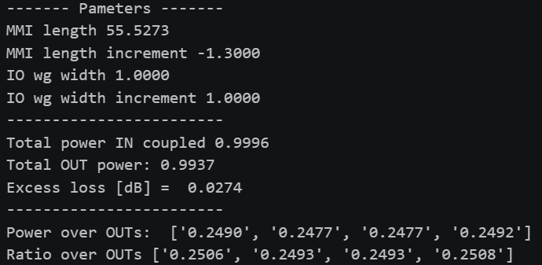
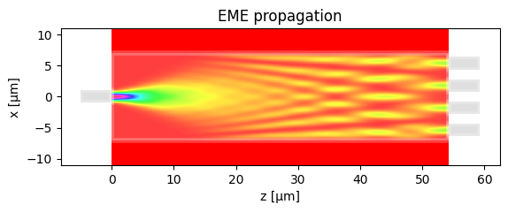
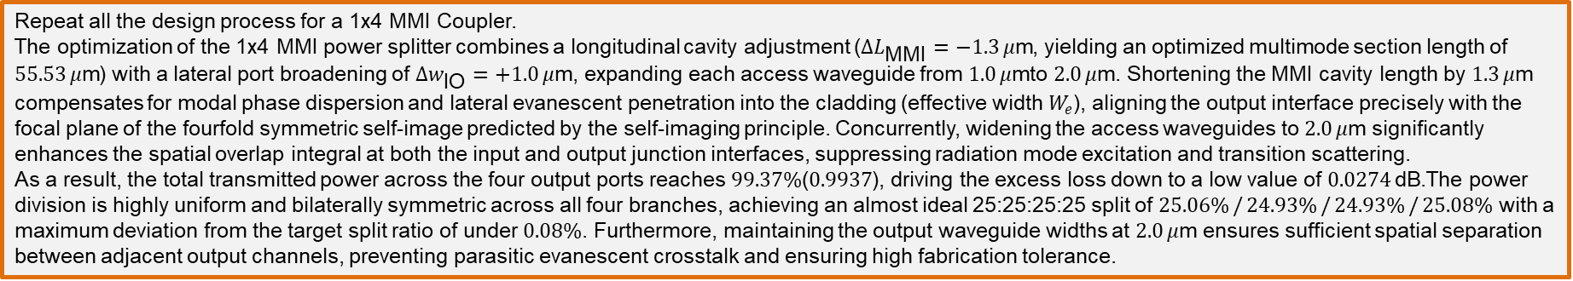
Learning outcome #5 – 1x4 Multimode Interference Coupler
Wavelength 1.55 µm, wMMI = ? µm
Repeat all the design process for a 1x4 MMI Coupler.
The optimization of the 1x4 MMI power splitter combines a longitudinal cavity adjustment ($ΔL_{\text{MMI}}=−1.3 μ\text{m}$, yielding an optimized multimode section length of $55.53 μ\text{m}$) with a lateral port broadening of $Δw_{\text{IO}}=+1.0 μ\text{m}$, expanding each access waveguide from $1.0 μ\text{m}$to $2.0 μ\text{m}$. Shortening the MMI cavity length by $1.3 μ\text{m}$ compensates for modal phase dispersion and lateral evanescent penetration into the cladding (effective width $W_{e}$), aligning the output interface precisely with the focal plane of the fourfold symmetric self-image predicted by the self-imaging principle. Concurrently, widening the access waveguides to $2.0 μ\text{m}$significantly enhances the spatial overlap integral at both the input and output junction interfaces, suppressing radiation mode excitation and transition scattering.
As a result, the total transmitted power across the four output ports reaches $99.37\%$($0.9937$), driving the excess loss down to a low value of $0.0274 \text{dB}\text{.}$The power division is highly uniform and bilaterally symmetric across all four branches, achieving an almost ideal 25:25:25:25 split of $25.06\% / 24.93\% / 24.93\% / 25.08\%$ with a maximum deviation from the target split ratio of under $0.08\%$. Furthermore, maintaining the output waveguide widths at $2.0 μ\text{m}$ ensures sufficient spatial separation between adjacent output channels, preventing parasitic evanescent crosstalk and ensuring high fabrication tolerance.

Slide 13
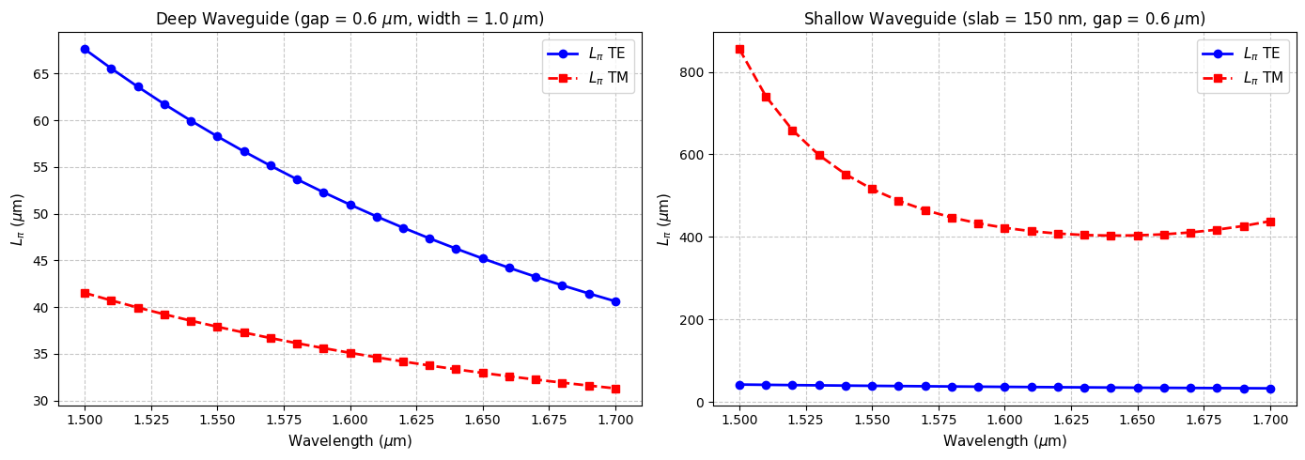


Extra #1 – Directional wavelength dependence
Wavelengths from 1.5 to 1.7 µm, gap = 0.6 µm, width 1.0 µm
deep waveguide
Paste $L_{π}$ vs wvl for TE and TM plot here
shallow waveguide
Paste $L_{π}$ vs wvl for TE and TM plot here
slab = 150nm

Slide 14
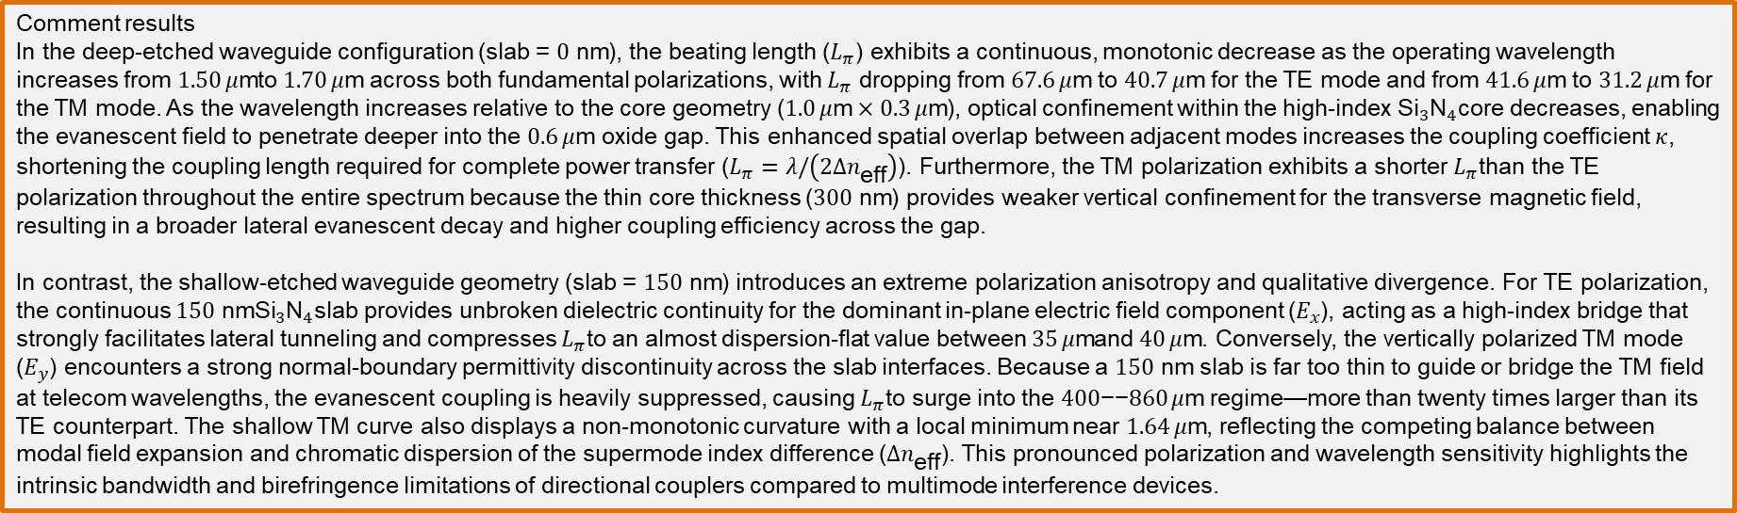
Extra #1 – Directional wavelength dependence
Wavelengths from 1.5 to 1.7 µm, gap = 0.6 µm, width 1.0 µm
Comment results
In the deep-etched waveguide configuration (slab = $0\text{ nm}$), the beating length ($L_{π}$) exhibits a continuous, monotonic decrease as the operating wavelength increases from $1.50 μ\text{m}$to $1.70 μ\text{m}$ across both fundamental polarizations, with $L_{π}$ dropping from $67.6 μ\text{m}$to $40.7 μ\text{m}$ for the TE mode and from $41.6 μ\text{m}$to $31.2 μ\text{m}$ for the TM mode. As the wavelength increases relative to the core geometry ($1.0 μ\text{m}×0.3 μ\text{m}$), optical confinement within the high-index ${\text{Si}}_{3}{\text{N}}_{4}$core decreases, enabling the evanescent field to penetrate deeper into the $0.6 μ\text{m}$ oxide gap. This enhanced spatial overlap between adjacent modes increases the coupling coefficient $κ$, shortening the coupling length required for complete power transfer ($L_{π}=λ/\left(2Δn_{\text{eff}}\right)$). Furthermore, the TM polarization exhibits a shorter $L_{π}$than the TE polarization throughout the entire spectrum because the thin core thickness ($300\text{ nm}$) provides weaker vertical confinement for the transverse magnetic field, resulting in a broader lateral evanescent decay and higher coupling efficiency across the gap.
In contrast, the shallow-etched waveguide geometry (slab = $150\text{ nm}$) introduces an extreme polarization anisotropy and qualitative divergence. For TE polarization, the continuous $150\text{ nm}{\text{Si}}_{3}{\text{N}}_{4}$slab provides unbroken dielectric continuity for the dominant in-plane electric field component ($E_{x}$), acting as a high-index bridge that strongly facilitates lateral tunneling and compresses $L_{π}$to an almost dispersion-flat value between $35 μ\text{m}$and $40 μ\text{m}$. Conversely, the vertically polarized TM mode ($E_{y}$) encounters a strong normal-boundary permittivity discontinuity across the slab interfaces. Because a $150\text{ nm}$ slab is far too thin to guide or bridge the TM field at telecom wavelengths, the evanescent coupling is heavily suppressed, causing $L_{π}$to surge into the $400\text{−−}860 μ\text{m}$ regime—more than twenty times larger than its TE counterpart. The shallow TM curve also displays a non-monotonic curvature with a local minimum near $1.64 μ\text{m}$, reflecting the competing balance between modal field expansion and chromatic dispersion of the supermode index difference ($Δn_{\text{eff}}$). This pronounced polarization and wavelength sensitivity highlights the intrinsic bandwidth and birefringence limitations of directional couplers compared to multimode interference devices.

Slide 15
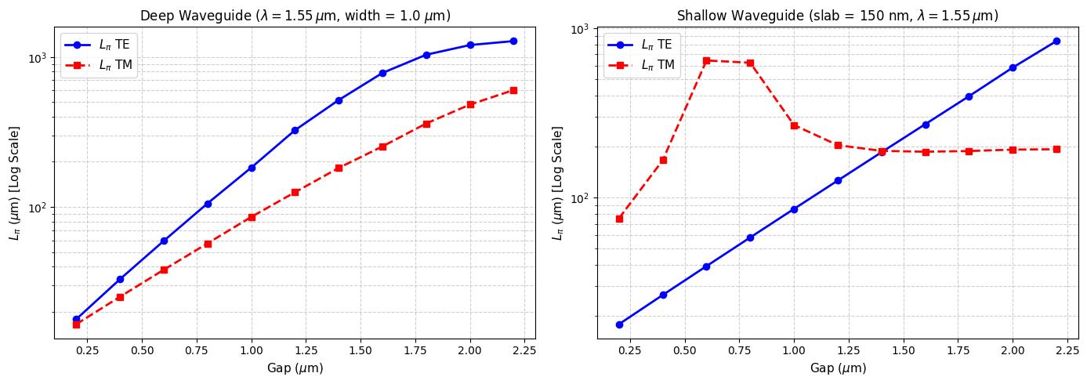
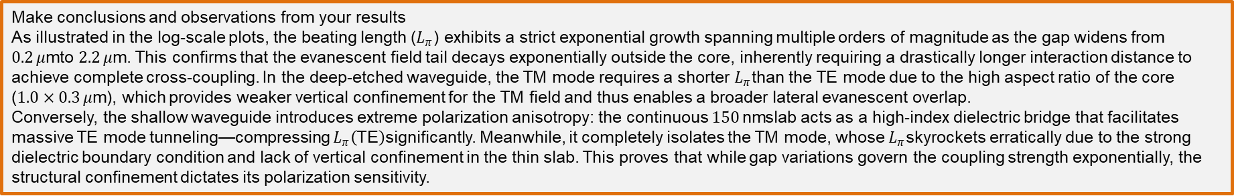
Extra #2 – Directional coupler gap dependence
Wavelength 1.55 µm, width 1.0 µm, gap 0.2-2.4 µm (step 0.2 µm)
Make conclusions and observations from your results
As illustrated in the log-scale plots, the beating length ($L_{π}$) exhibits a strict exponential growth spanning multiple orders of magnitude as the gap widens from $0.2 μ\text{m}$to $2.2 μ\text{m}$. This confirms that the evanescent field tail decays exponentially outside the core, inherently requiring a drastically longer interaction distance to achieve complete cross-coupling. In the deep-etched waveguide, the TM mode requires a shorter $L_{π}$than the TE mode due to the high aspect ratio of the core ($1.0×0.3 μ\text{m}$), which provides weaker vertical confinement for the TM field and thus enables a broader lateral evanescent overlap.
Conversely, the shallow waveguide introduces extreme polarization anisotropy: the continuous $150 \text{nm}$slab acts as a high-index dielectric bridge that facilitates massive TE mode tunneling—compressing $L_{π}\left(\text{TE}\right)$significantly. Meanwhile, it completely isolates the TM mode, whose $L_{π}$skyrockets erratically due to the strong dielectric boundary condition and lack of vertical confinement in the thin slab. This proves that while gap variations govern the coupling strength exponentially, the structural confinement dictates its polarization sensitivity.

Slide 16
Extra #3 – MMI coupler wavelength dependence
Wavelengths from 1.5 to 1.7 µm, wMMI = 6.6 µm
deep waveguide
Paste $L_{π}$ vs wvl for TE and TM plot here
shallow waveguide
Paste $L_{π}$ vs wvl for TE and TM plot here
slab = 150nm
Comment results (Important. Compare with Directional Coupler)

Slide 17


Extra #4 – MMI coupler body width dependence
Wavelength 1.55 µm, wMMI = 5-10 µm (steps 0.5 µm)
deep waveguide
Paste $L_{π}$ vs width for TE and TM plot here
shallow waveguide
Paste $L_{π}$ vs width for TE and TM plot here
slab = 150nm
Polarization independent coupler: is there any point for which the MMI coupler can work identically for TE and TM? Answer yes / no and explain why?

Slide 18
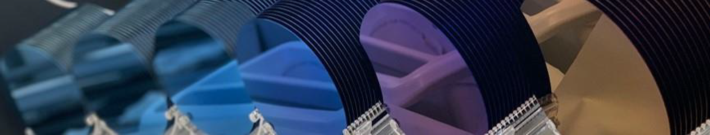
Thank you

